Slide 1
Fists, Ladders and Windows
What’s Behind how you Perceive, Understand and Act

Slide 2
You think you’re in control of yourself

Slide 3
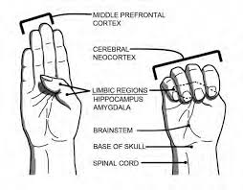
This is your Brain
The Limbic System
Big emotions, anger, fear, acts on instinct, fight, flight, freeze

Slide 4
This is your Brain
The Prefrontal Cortex
Wise Leader, integrates ideas, controls behavior

Slide 5
This is your Brain
The Prefrontal Cortex
Wise Leader, integrates ideas, controls behavior
The Limbic System
Big emotions, anger, fear, acts on instinct, fight, flight, freeze

Slide 6
Fight, Flight, Freeze Triggers

Slide 7
Fight, Flight, Freeze Triggers
S = Status
C = Certainty
A = Autonomy
R = Relatedness
F = Fairness

Slide 8
You think you’re Objective & Neutral

Slide 9
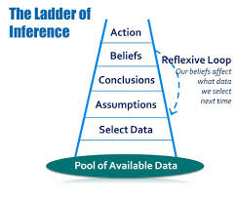
The Ladder of Inference

Slide 10
The Ladder of Inference

Slide 11
The Ladder of Inference

Slide 12
Climb Carefully!

Slide 13
You think you know yourself

Slide 14
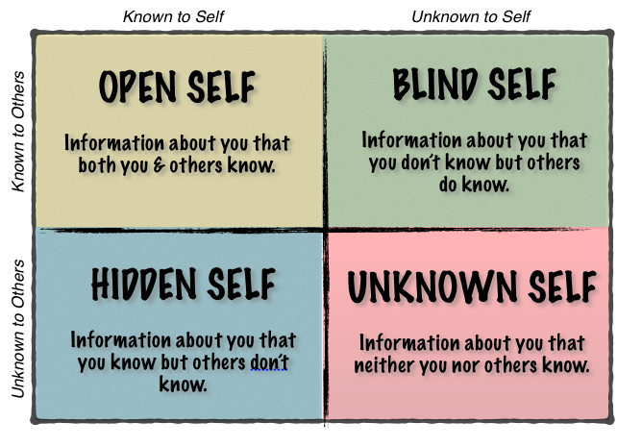
The Johari Window

Slide 15
The Johari Window
Hidden
Open
Unknown
Blind
Hidden
Open
Unknown
Blind

Slide 16
The Johari Window
Hidden
Open
Unknown
Blind
Hidden
Open
Unknown
Blind

Slide 17
The Johari Window
Hidden
Open
Unknown
Blind
Hidden
Open
Unknown
Blind

Slide 18
Yes, You Can
…be more in control of yourself than you think
…practice increasing your objectivity and neutrality
…know yourself better

Slide 19
Learn More…
Dr. Daniel Siegel’s Mindsight (2010)
Brain/Hand model
Techniques & Tools to give your Brain the space it needs to be at its best
Greater respect for differences that are beyond our conscious will
David Rock’s Your Brain at Work (2009)
SCARF model
Techniques & Tools to give your Brain the space it needs to be it’s best
NeuroLeadership Institute

Slide 20
Learn More…
Johari Window (1955)
Joseph Luft
Harrington Ingham
Kevan.org/johari for a test to see how your assessment of yourself overlaps with how others see you
Ladder of Inference (1970s)
Chris Argyris
Learning Org guru, founder of org development

